Slide 1
ETLC_ApexBridge
Design pattern for communication between Lightning Components and Apex
Andrés Pérez
Master Technical Instructor, Salesforce University
@ELTOROIT

Slide 2
Forward-Looking Statements
Statement under the Private Securities Litigation Reform Act of 1995:
This presentation may contain forward-looking statements that involve risks, uncertainties, and assumptions. If any such uncertainties materialize or if any of the assumptions proves incorrect, the results of salesforce.com, inc. could differ materially from the results expressed or implied by the forward-looking statements we make. All statements other than statements of historical fact could be deemed forward-looking, including any projections of product or service availability, subscriber growth, earnings, revenues, or other financial items and any statements regarding strategies or plans of management for future operations, statements of belief, any statements concerning new, planned, or upgraded services or technology developments and customer contracts or use of our services.
The risks and uncertainties referred to above include – but are not limited to – risks associated with developing and delivering new functionality for our service, new products and services, our new business model, our past operating losses, possible fluctuations in our operating results and rate of growth, interruptions or delays in our Web hosting, breach of our security measures, the outcome of any litigation, risks associated with completed and any possible mergers and acquisitions, the immature market in which we operate, our relatively limited operating history, our ability to expand, retain, and motivate our employees and manage our growth, new releases of our service and successful customer deployment, our limited history reselling non-salesforce.com products, and utilization and selling to larger enterprise customers. Further information on potential factors that could affect the financial results of salesforce.com, inc. is included in our annual report on Form 10-K for the most recent fiscal year and in our quarterly report on Form 10-Q for the most recent fiscal quarter. These documents and others containing important disclosures are available on the SEC Filings section of the Investor Information section of our Web site.
Any unreleased services or features referenced in this or other presentations, press releases or public statements are not currently available and may not be delivered on time or at all. Customers who purchase our services should make the purchase decisions based upon features that are currently available. Salesforce.com, inc. assumes no obligation and does not intend to update these forward-looking statements.

Slide 3
Agenda
So what are we talking about?
ETLC_ApexBridge Basic Architecture
Why do we need it?
How to use it?
Example #1a: Hello World
The most basic example
Example #1b: Passing A String To Apex
Sending basic data to Apex
Example #2: Creating A Record
Sending more complex data to Apex
Example #3: Mass Edit Records
Sending records to Apex
Q&A

Slide 4
ETLC_ApexBridge
Basic Architecture
@ELTOROIT

Slide 5
ETLC_ApexBridge
Why do we need it?
Lightning Components helps build Single Page Architecture (SPA) applications
Most logic happens on the client via JavaScript
Back end is still required
Reading and writing data to your custom and standard objects
Sending emails
Talking to external web servers
Invoking Salesforce APIs

Slide 6
ETLC_ApexBridge
Why do we need it?
Implementing the client-server communication using documented solutions can be tedious and it's not reusable!
Doesn't Salesforce provide the Lightning Data Service to help me with this?
Lightning Data Service is in Developer Preview (Spring '17)
You need to wait a few releases ;-)
Lightning Data Service is similar to Standard Controller in Visualforce.
Often you require Custom Controllers and Controller Extensions!

Slide 7
ETLC_ApexBridge
How to use it?
Install code from Github to your ORG
http://www.github.com/ELTOROIT/ETLC_ApexBridge
Create your own code
Create a Lightning Component that will call Apex
Create Apex class that makes a SOQL query, DML, or anything else needed
ETLC_ApexBridge takes care of managing the communication and handling errors!

Slide 8
ETLC_ApexBridge Architecture
How does it work?
Client
Server
Your code
ETLC_ApexBridge's code
ETLC_ApexBridge_Abstract
yourClass
ETLC_SecuredDB
<c:yourComponent />
ETLC_ApexBridge_Controller
Create your component
Nest <c:ETLC_ApexBridge /> component in your component
Install code from Github
Create your class, which extends ETLC_ApexBridge_Abstract
Perform any SOQL or DML
operations with Salesforce data
using ETLC_SecureDB
<c:ETLC_ApexBridge /> JavaScript invokes a method in the ETLC_ApexBridge_Controller class
At runtime… your component calls a method in <c:ETLC_ApexBridge />
ETLC_ApexBridge_Controller calls your class to process the request.
<c:ETLC_ApexBridge />

Slide 9
ETLC_ApexBridge
Example #1
Hello World
The most simple request
@ELTOROIT

Slide 10
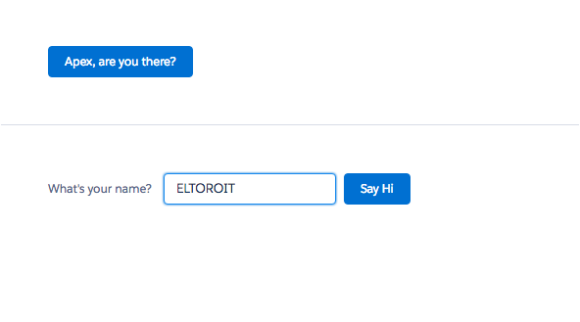
ETLC_ApexBridge: Hello World
First demo, the most simple use case, we just click a button and call Apex
What are we building?

Slide 11
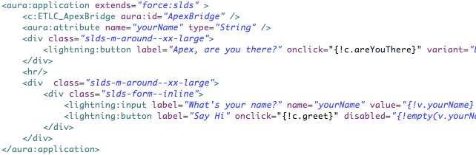
ETLC_ApexBridge: Hello World
Nest <c:ETLC_ApexBridge /> in your component
On the click of this button call Apex
In your component's markup…

Slide 12
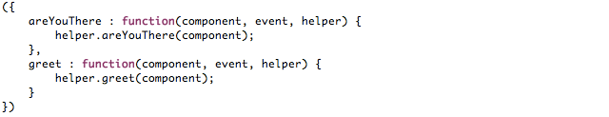
ETLC_ApexBridge: Hello World
This is the controller, most of the work will be done in the helper ;-)
In your component's controller…

Slide 13
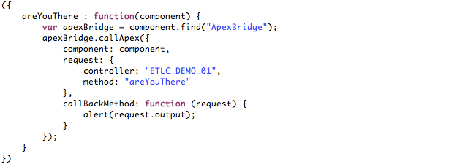
ETLC_ApexBridge: Hello World
Make the request
Pass a reference to your component
Process the data received
Define the callback function,
(this will run asynchronously).
Specify the controller (Apex class) that your controller will invoke…
… and the method that will
handle the request.
Get a reference to the
ETLC_ApexBridge component
In your component's helper …

Slide 14
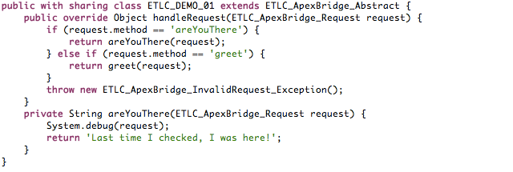
ETLC_ApexBridge: Hello World
Create a class implementing ETLC_ApexBridge_Abstract
Create an if "section" for each method that you expect to be invoked.
Override handleRequest().
Note: The request to be processed
is passed as a parameter
Return the output expected by
your component. You may want to
use a helper method.
Helper method. It takes the request
and can return any parameter (String, Boolean, List<Account>, … )
This handles the case when method requested has not been implemented (or it has been mistyped).
In your Apex code…

Slide 15
ETLC_ApexBridge
Example #1b
Passing a string to Apex
Same markup and controller as previous sample
@ELTOROIT

Slide 16
ETLC_ApexBridge: Sending basic (non-records) data
Second part will send
a string value to Apex.
What are we building?

Slide 17
ETLC_ApexBridge: Sending basic (non-records) data
We'll use the same
component markup
But... it will be the
click of this button…
In your component's markup…

Slide 18
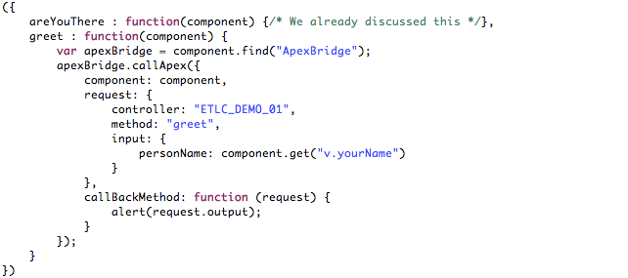
ETLC_ApexBridge: Sending basic (non-records) data
Very similar to previous example…
Just pass data in the input field
In your component's helper…

Slide 19
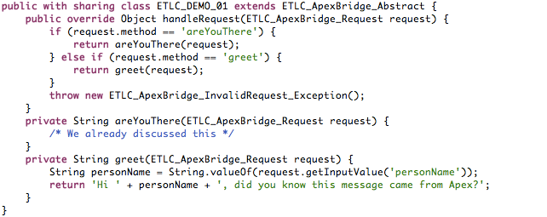
ETLC_ApexBridge: Sending basic (non-records) data
Use the methods in the
request to get the data
In your Apex code…
Did you notice that a single component can invoke different methods, maybe in different controllers ;-)

Slide 20
ETLC_ApexBridge
Example #2
Creating A Record
Sending more complex data, but not sObject records (yet)
@ELTOROIT

Slide 21
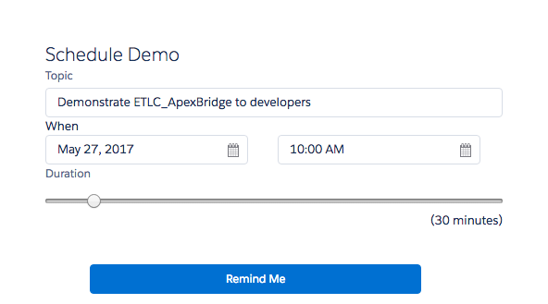
ETLC_ApexBridge: Creating A Record
Apex will create a new Event record
with the information in this form
What are we building?

Slide 22
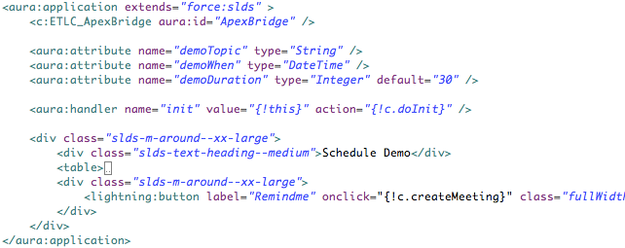
ETLC_ApexBridge: Creating A Record
Nest <c:ETLC_ApexBridge /> in your component
Define some attributes…
Click button to create record
In your component's markup…

Slide 23
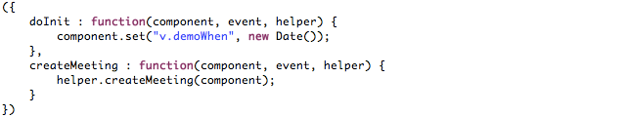
ETLC_ApexBridge: Creating A Record
This is the controller, most of the work will be done in the helper ;-)
In your component's controller…

Slide 24
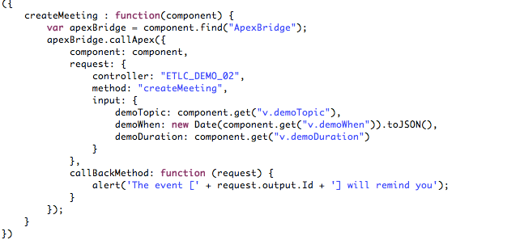
ETLC_ApexBridge: Creating A Record
Passing the 3 required fields
to create an event.
Dates and times require a special handling in client and server to ensure their values are not messed up.
In your component's helper …
Can't send sObject record(s) using this technique, but
can receive any type of data including sObject record(s).

Slide 25
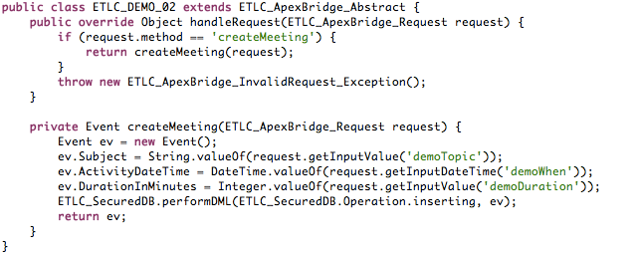
ETLC_ApexBridge: Creating A Record
Use the methods in the
request to get the data
The methods in ETLC_SecureDB class helps you write secure code.
Remember: Dates and times work a bit differently… Use special methods to extract them from the request
In your Apex code…
Warning: Lightning Components does not respect the user's security (CRUD, FLS)! This class ensures security is respected.

Slide 26
ETLC_ApexBridge
Example #3
Mass Edit Accounts
Send sObject records to Apex
@ELTOROIT

Slide 27
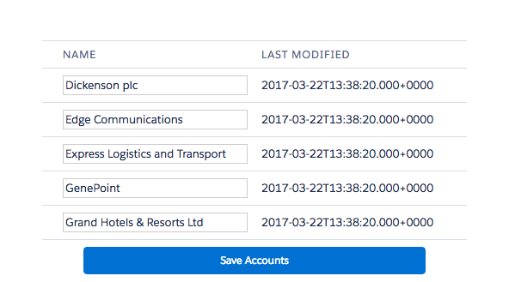
ETLC_ApexBridge: Mass Edit Accounts
Queries for accounts when loading, and sends multiple records to Apex on click.
What are we building?

Slide 28
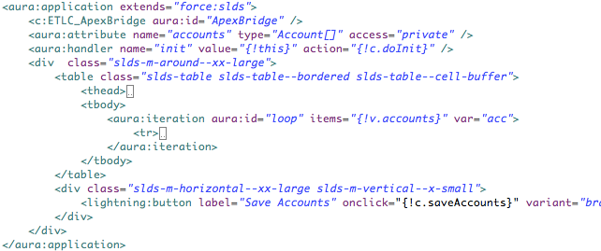
ETLC_ApexBridge: Mass Edit Accounts
Create attribute to hold accounts
Loop through the accounts,
to request new vales from user
Nest <c:ETLC_ApexBridge /> in your component
Click button so save changes
On initialization, query the accounts
In your component's markup…

Slide 29
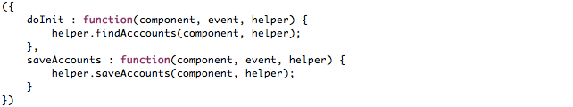
ETLC_ApexBridge: Mass Edit Accounts
This is the controller, most of the work will be done in the helper ;-)
In your component's controller…

Slide 30
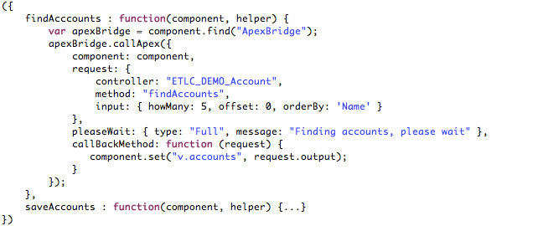
ETLC_ApexBridge: Mass Edit Accounts
This will fetch the accounts, it works very similar to what we have discussed
These parameters will be used
in the SOQL query built in Apex
Controls the "please wait" message displayed while Apex is busy.
In your component's helper… (Query)

Slide 31
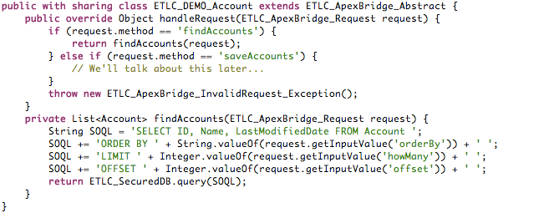
ETLC_ApexBridge: Mass Edit Accounts
We are using the findAccounts method
Perform a secure SOQL query
Make SOQL query using parameters passed from client-side controller
In your Apex code… (Query)

Slide 32
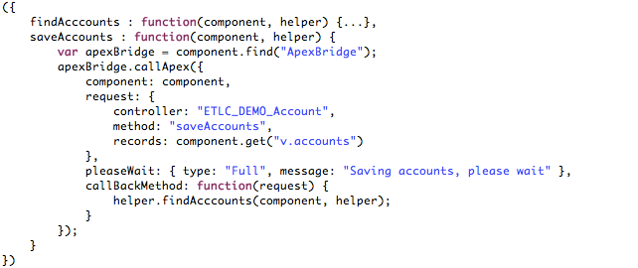
ETLC_ApexBridge: Mass Edit Accounts
This will save the accounts, it works very similar to what we have discussed with few exceptions ;-)
When Apex returns, call helper function to find the accounts
To pass records, do not use input…
use records!
In your component's helper… (Update)
The records could be returned from Apex,
but I wanted to show how to chain Apex calls

Slide 33
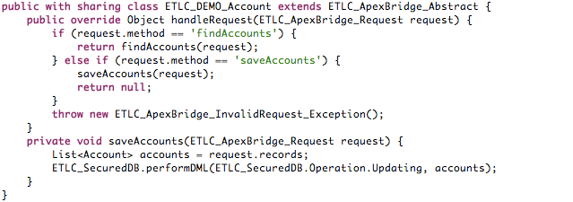
ETLC_ApexBridge: Mass Edit Accounts
Get the records passed
from client-side controller
Perform secured DML operation
In your Apex code… (Update)

